Slide 1

Kaustuk Pratap Singh
24-06-2025

Slide 2

Outline
Executive Summary
Introduction
Methodology
Results
Conclusion
Appendix

Slide 3
Executive Summary
Objective
Analyze SpaceX launch data to understand success trends, payload effects, and site performance, and to build a predictive model for mission success.
Summary of methodologies
Data Preparation: Cleaned and explored the spacex_launch_dash.csv dataset.
Dashboard: Built an interactive dashboard using Plotly Dash with dropdowns, sliders, pie charts, and scatter plots.
Modeling: Used Logistic Regression and Decision Tree with GridSearchCV to predict launch success.
Summary of all results
Most launches were successful; Kennedy Space Center had the highest launch volume.
Payload mass showed no strong correlation with mission success.
Booster versions influenced outcomes more than payload.
Models achieved ~85–88% accuracy in predicting success.

Slide 4
Introduction
🛰️ Project Background & Context
SpaceX is a private aerospace company known for its ambitious goal of reducing the cost of space travel and enabling the colonization of Mars. To improve operational efficiency and mission planning, it's essential to analyze historical launch data to uncover patterns related to mission outcomes.
With growing data from various launches, visual and predictive tools are needed to help decision-makers quickly assess performance trends, site reliability, and factors influencing launch success
Problems We Aimed to Solve
Which launch sites have the highest success rates?
Is there a relationship between payload mass and launch success?
Do different booster versions impact mission outcomes?
Can we predict whether a future launch will succeed based on key parameters?

Slide 5

Section 1

Slide 6
Methodology
Data Collection: Used SpaceX launch data with features like launch site, payload ,booster, and outcome.
Data Wrangling: Cleaned data, handled missing values, standardized payload ranges, and encoded categories.
EDA: Visualized site success rates, payload vs. outcome trends, and booster performance using Pandas, SQL, and Plotly.
Interactive Analytics: Built a dashboard with dropdowns, pie charts, and scatter plots using Plotly Dash. (Folium optional for maps.)
Predictive Modeling: Applied Logistic Regression and Decision Trees, optimized with GridSearchCV, and evaluated accuracy.

Slide 7
SpaceX API – For real-time and structured launch data
Web Scraping – Used BeautifulSoup to extract booster and mission info from public sites.
SQL Databases – Used for querying and filtering launch record
Data Collection
Data Sources:
Work Flow for Data Collection:
Start ⟶ Query SpaceX API & Web Scrape Metadata ⟶ Parse to DataFrames ⟶ Apply SQL Filters ⟶ Merge CSVs

Slide 8
Data Collection – SpaceX API
Objective
In this lab, you will make a get request to the SpaceX API. You will also do some basic data wrangling and formatting.
Request to the SpaceX API
Clean the requested data
GitHub URL for Rest API Notebook.
https://github.com/kaustuk000/SpaceX-Landing-Pridictor/blob/main/jupyter-labs-spacex-data-collection-api.ipynb
API CALL
Pandas
Request API to assess the Data
Used to Covert the Loaded Data into Dataframe
Filtering
Filtered the Dataframe to collect data for Falcon9.
Save
Saved the filtered Dataframe as a csv file

Slide 9
Data Collection - Scraping
Request
Praising the html using BeautifulSoup
Filtering Tables
Collecting and Storing data in dataframe
Exporting the data as a csv file.
Used Wikipedia for Web Scrapping
GitHub Link for Web Scrapping Notebook
https://github.com/kaustuk000/SpaceX-Landing-Pridictor/blob/main/jupyter-labs-webscraping.ipynb

Slide 10
Data Wrangling
Data Extraction ‣ Web scraped SpaceX Wikipedia tables using Beautiful ‣ Pulled API data & SQL queries
Data Cleaning ‣ Removed nulls, trimmed text ‣ Standardized date formats
Data Transformation ‣ Parsed columns (e.g. Landing_Outcome) ‣ Converted payload to numeric
Data Integration ‣ Merged multiple sources into one table ‣ Stored in SQLite for querying
Data Validation ‣ Checked outcome counts, date ranges ‣ Filtered & ranked for analysis
Extract
Clean
Transform
Integrate
Validate
https://github.com/kaustuk000/SpaceX-Landing-Pridictor/blob/main/labs-jupyter-spacex-Data%20wrangling.ipynb

Slide 11
EDA with Data Visualization
Categorical Plot between Flight Number and Launch Site suggest as the flight number increase success rate increase for all Launch Site.
Plot between Payload Mass and Launch Site suggest for the VAFB-SLC launch site there are no rockets launched for heavy payload mass(greater than 10000).
Using the Bar plot we saw GTO orbit has the most success.
Year Launch Success Rate suggests success rate has drastically
increased since 2013.
GitHub Link for the Notebook:
https://github.com/kaustuk000/SpaceX-Landing-Pridictor/blob/main/jupyter-labs-eda-dataviz.ipynb

Slide 12
EDA with SQL
Created a Table named SPACEXTABLE
Find Distinct Launch Site
Done some string matching filtering using like .
Find the average Payload mass for Booster version F9 V1.1
Listed the names of the boosters which have success in drone ship and have payload mass greater than 4000 but less than 6000
List the total number of successful and failure mission outcomes
Used subquery to filter some Data.
Find the months for year 2015 for which landing was a failure for drone ship landing.
https://github.com/kaustuk000/SpaceX-Landing-Pridictor/blob/main/jupyter-labs-eda-sql-coursera_sqllite.ipynb

Slide 13
Build an Interactive Map with Folium
Markers
Added to mark SpaceX launch sites on the map
Help users quickly locate each launchpad
Circle Markers
Represent payload ranges or success rates visually
Provide clearer distinction between sites with overlapping locations
Popups & Tooltips
Show detailed site info (site name, success count, etc.) on hover or click
Improve interactivity and user understanding
Polylines
Used to connect launch sites to nearest coastal site.
Visualize spatial relationships between launch sites or paths
https://github.com/kaustuk000/SpaceX-Landing-Pridictor/blob/main/lab-jupyter-launch-site-location-v2%20(1).ipynb

Slide 14
Build a Dashboard with Plotly Dash
Plots/Graphs Added:
Success Pie Chart
Shows: Proportion of successful launches by site
Interaction: Updates when a launch site is selected from the dropdown
Why: Helps compare site-wise performance at a glance
Success-Failure Pie Chart (per site)
Shows: Distribution of success (1) vs. failure (0) for selected site
Interaction: Triggered when a specific site is chosen
Why: Provides insight into each site's reliability
Payload vs. Success Scatter Plot
Shows: Relationship between payload mass and launch outcome
Interaction: Filters based on site and payload range via dropdown + slider
Why: To explore whether payload mass correlates with mission success, and how booster types vary
https://github.com/kaustuk000/SpaceX-Landing-Pridictor/blob/main/spacexDashboard.py

Slide 15
Predictive Analysis (Classification)
Models Tried:
1 - Logistic Regression
2 - Support Vector Regression
3 - DecisionTreeClassifier
4 - K Nearest Neighbors Classifier (R^2 = 0.944)
I say KNN performs best. One can think why not Logistic its because the difference between the training
GitHub Link for Notebook
https://github.com/kaustuk000/SpaceX-Landing-Pridictor/blob/main/SpaceX_Machine_Learning_Prediction_Part_5.jupyterlite.ipynb

Slide 16
Results
Exploratory data analysis results
Interactive analytics demo in screenshots
Predictive analysis results

Slide 17

Section 2

Slide 18
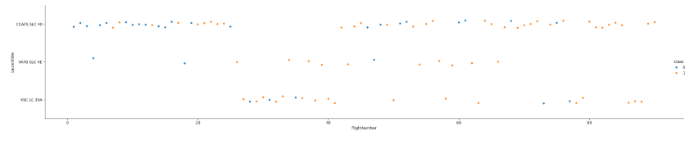
As the flight Number increases success rate on each Launch site increase
Flight Number vs. Launch Site

Slide 19
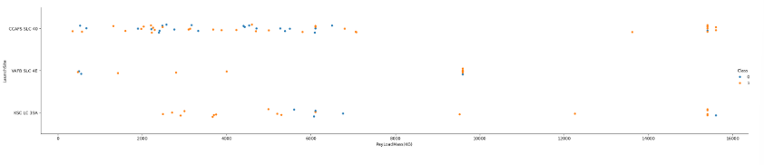
Payload vs. Launch Site
Payload Mass Vs. Launch Site scatter point chart you will find for the VAFB-SLC launch site there are no rockets launched for heavy payload mass(greater than 10000).

Slide 20
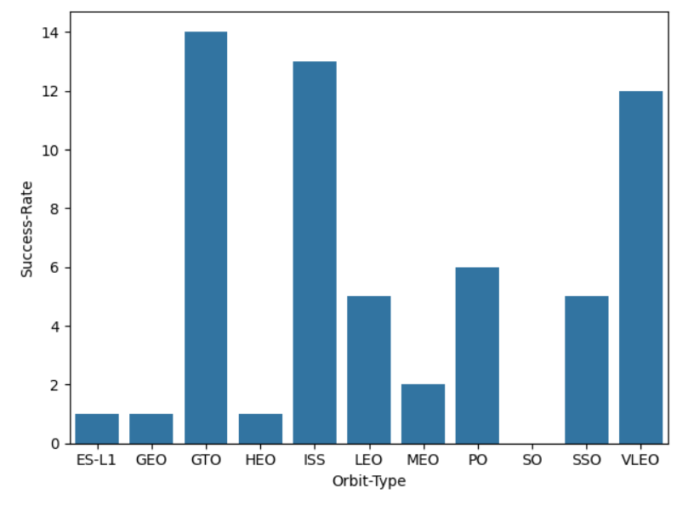
Success Rate vs. Orbit Type
Orbit GTO has the Highest success rate.
Orbit ISS and VLEO have good success rate as well.
Where as Orbit like ES-L1, GEO, HEO, MEO as every low success rate
Orbit SO has 0 success rate.

Slide 21
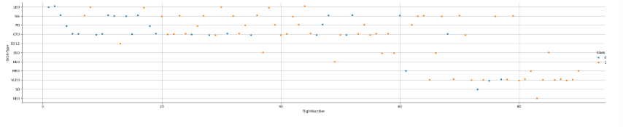
Flight Number vs. Orbit Type
Observe that in the LEO orbit, success seems to be related to the number of flights. Conversely, in the GTO orbit, there appears to be no relationship between flight number and success.

Slide 22
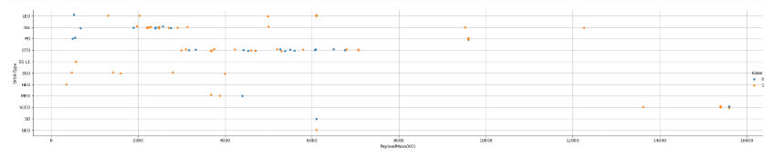
Payload vs. Orbit Type
With heavy payloads the successful landing or positive landing rate are more for Polar, LEO and ISS.
However, for GTO, it's difficult to distinguish between successful and unsuccessful landings as both outcomes are present

Slide 23
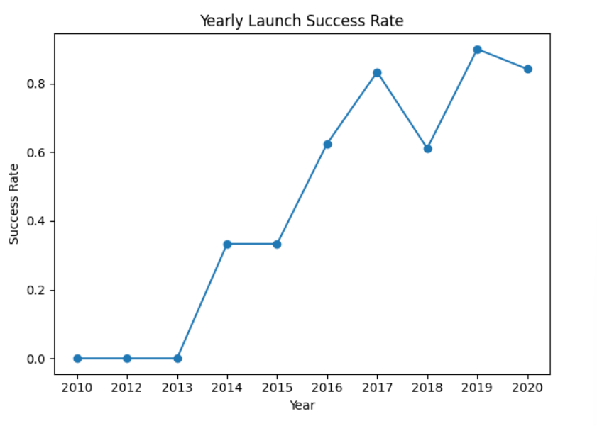
Launch Success Yearly Trend
Observe that the success rate since 2013 kept increasing till 2020

Slide 24
All Launch Site Names
Names of the unique launch sites
Total of 4 unique launch sites were used to launch Falcon9.
CCAFS LC-40
VAFB SLC-4E
KSC LC-39A
CCAFS SLC-40

Slide 25
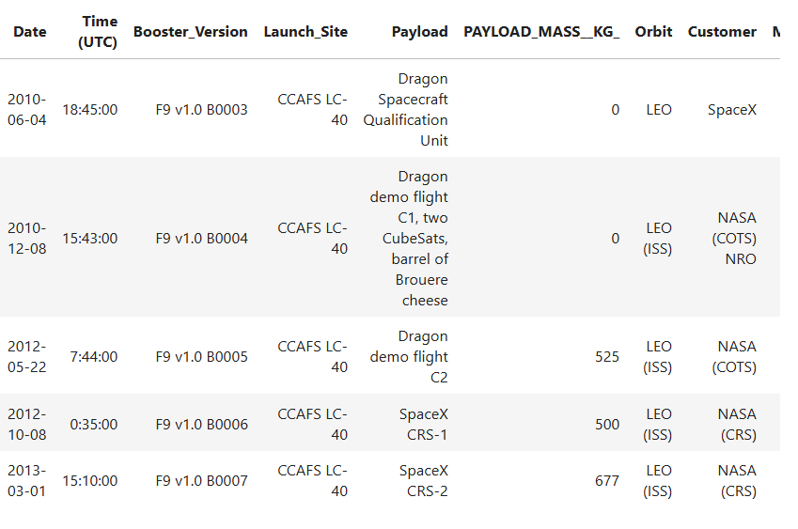
Launch Site Names Begin with 'CCA'
Find 5 records where launch sites begin with `CCA`
For all these 5 records Orbit
LEO has been Used.

Slide 26
Total Payload Mass
Total payload carried by boosters from NASA
48213
Total payload carried by boosters from NASA is 48213.

Slide 27
Average Payload Mass by F9 v1.1
Average payload mass carried by booster version F9 v1.1
The avg Payload mass carried by booster version F9 v1.1 is 2534.67
Mean
2534.6666666666665

Slide 28
First Successful Ground Landing Date
Find the dates of the first successful landing outcome on ground pad
Date
2015-12-22
2016-07-18
2017-02-19
2017-05-01
2017-06-03

Slide 29
Successful Drone Ship Landing with Payload between 4000 and 6000
List the names of boosters which have successfully landed on drone ship and had payload mass greater than 4000 but less than 6000
Booster_Version
F9 FT B1020
F9 FT B1022
F9 FT B1026
F9 FT B1021.2
F9 FT B1031.2

Slide 30
Total Number of Successful and Failure Mission Outcomes
Calculate the total number of successful and failure mission outcomes
Mission_Outcome | Total
Failure (in flight) | 1
Success | 98
Success | 1
Success (payload status unclear) | 1

Slide 31
Boosters Carried Maximum Payload
List the names of the booster which have carried the maximum payload mass
Booster_Version | PAYLOAD_MASS__KG_
F9 B5 B1048.4 | 15600
F9 B5 B1049.4 | 15600
F9 B5 B1051.3 | 15600
F9 B5 B1056.4 | 15600
F9 B5 B1048.5 | 15600
F9 B5 B1051.4 | 15600
F9 B5 B1049.5 | 15600
F9 B5 B1060.2 | 15600
F9 B5 B1058.3 | 15600
F9 B5 B1051.6 | 15600
F9 B5 B1060.3 | 15600
F9 B5 B1049.7 | 15600

Slide 32
2015 Launch Records
List the failed landing_outcomes in drone ship, their booster versions, and launch site names for in year 2015
Month | Booster_Version | Launch_Site | Landing_Outcome
01 | F9 v1.1 B1012 | CCAFS LC-40 | Failure (drone ship)
04 | F9 v1.1 B1015 | CCAFS LC-40 | Failure (drone ship)

Slide 33
Rank Landing Outcomes Between 2010-06-04 and 2017-03-20
Rank the count of landing outcomes (such as Failure (drone ship) or Success (ground pad)) between the date 2010-06-04 and 2017-03-20, in descending order
Landing_Outcome | Outcome_Count
No attempt | 10
Success (drone ship) | 5
Failure (drone ship) | 5
Success (ground pad) | 3
Controlled (ocean) | 3
Uncontrolled (ocean) | 2
Failure (parachute) | 2
Precluded (drone ship) | 1

Slide 34

Section 3

Slide 35
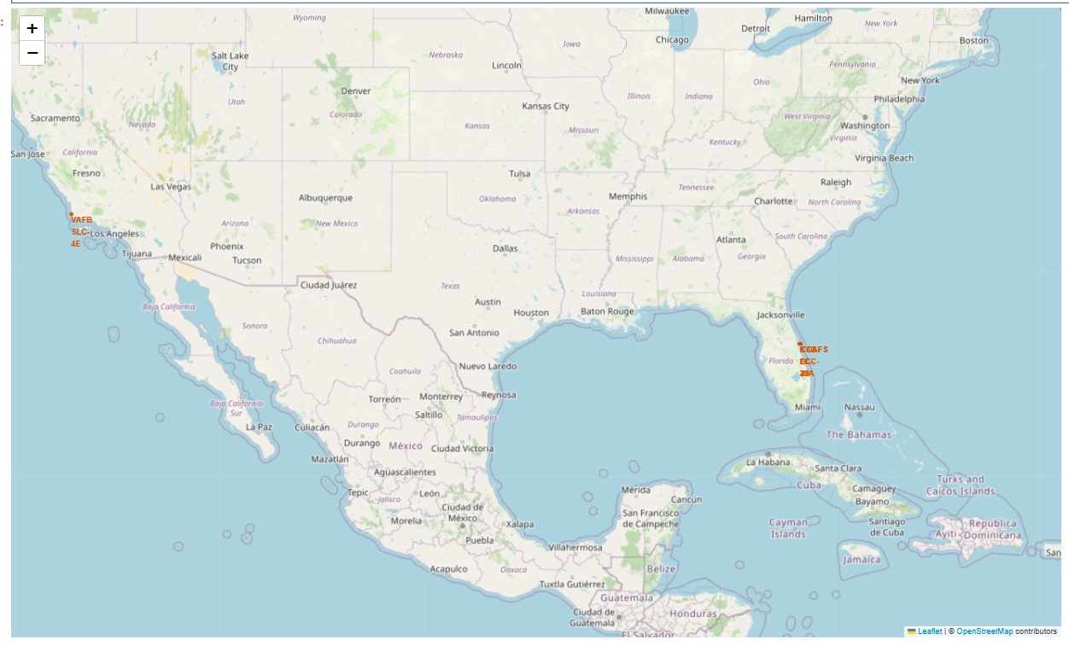
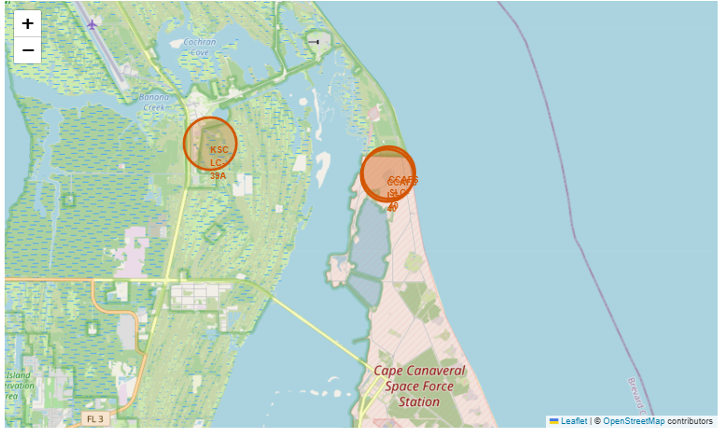
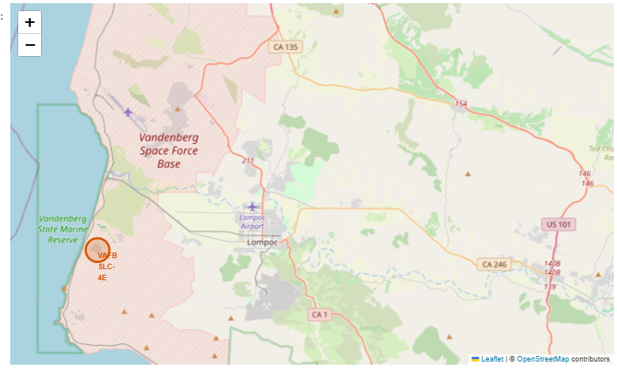
Map show 4 Launch site location on Map. Location of CCAFS LC-40 and CCAFS SLC-40 are very close so they appear like in same place
Launch Site Map 1

Slide 36
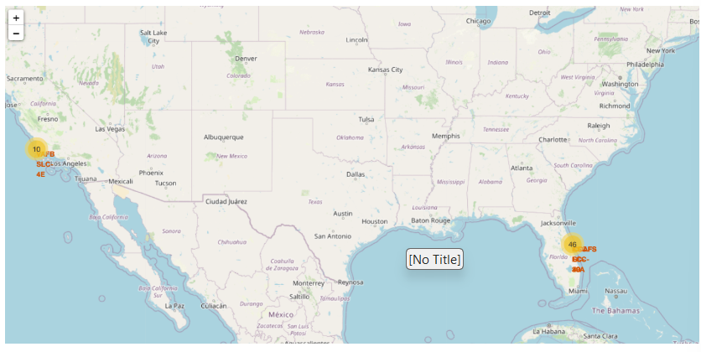
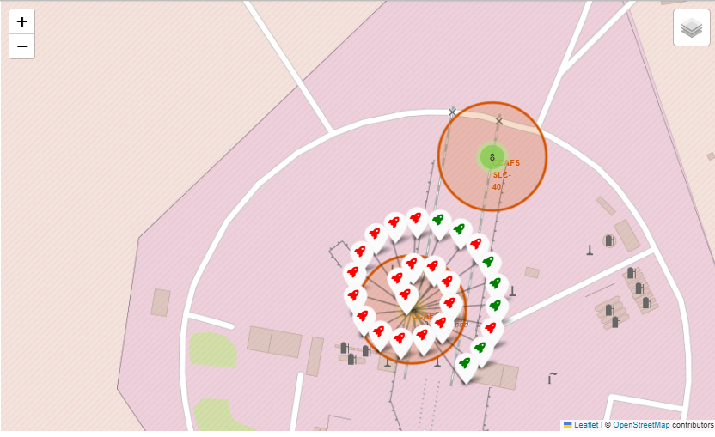
Launch Success/Failure
This map is showing the success/ failure in a form of green/red rocket icons.

Slide 37
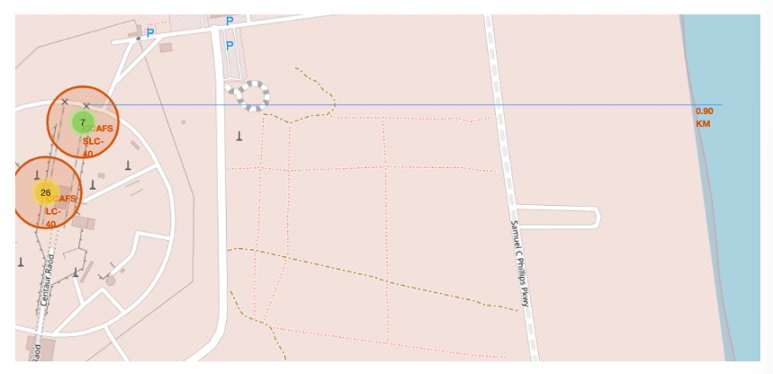
Minimum Distance to costal plane.
Map Showing the closet Distance of costal area to the Launch Site
Its coming to be 0.90KM

Slide 38

Section 4

Slide 39
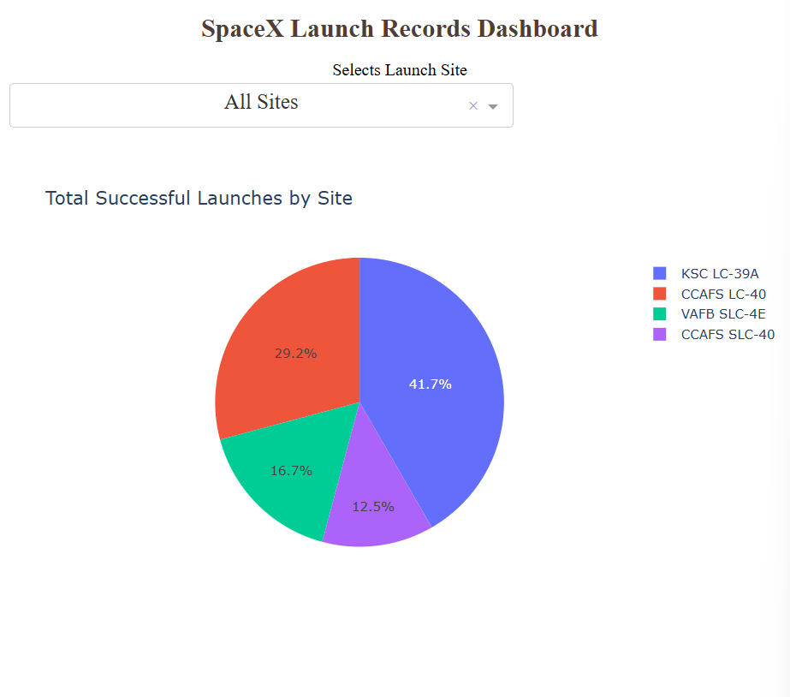
Dashboard Pie Chart 1
The Pie Chart showing the success rate to each other Launch Sites.
KSC LC-39A has the highest success percentage of 41.7% against other Launch Sites.

Slide 40
KSC LC-39A
Pie chart shows the Success vs. Failure for the site.
It has 76.9% of success which is 10 out of 13 Total Launches.

Slide 41
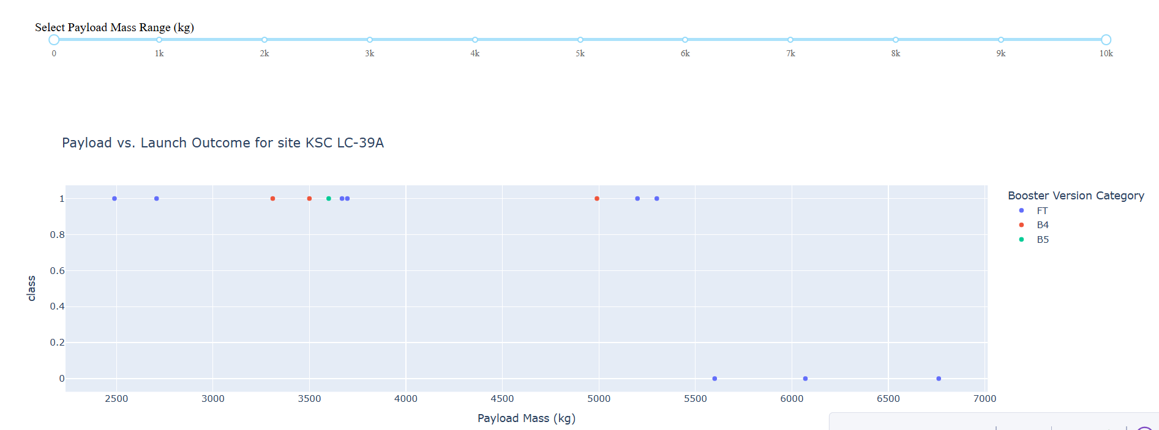
Class vs PayLoad
Scatter Plot explains the success for each Booster version for various PayLoad Mass(Kg)

Slide 42

Section 5

Slide 43
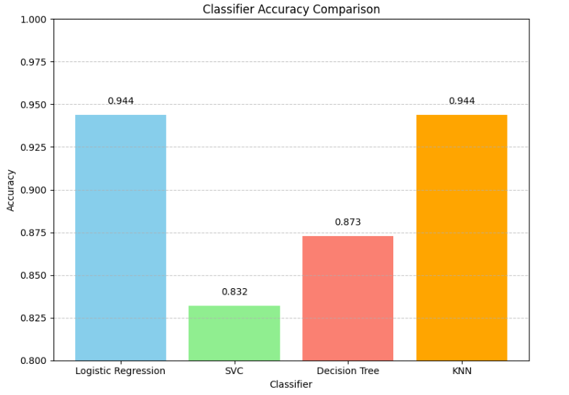
Classification Accuracy
Bar Chart shows the accuracy for different models.
KNN and Logistic Regression Gave the best.

Slide 44
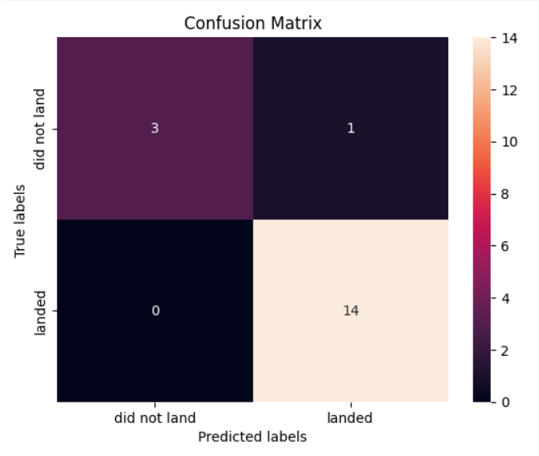
Confusion Matrix
The Confusion Matrix of KNN Classification
Suggest model correctly predicted total of 17 outcomes.
Wrongly Predicted 1 Outcome where it predicted landed but true outcome was did not land(Failure)

Slide 45
Conclusions
Score on test set was same for both Logistic
Regression and KNN .
Prediction of both on test data were same as well.
But KNN performs better on training Data then the Logistic Regression so,
We have chosen KNN as our final model.

Slide 46
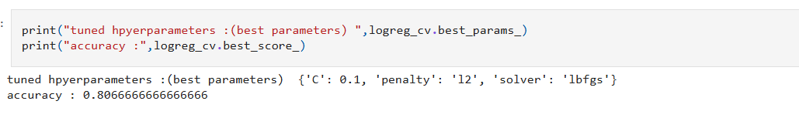
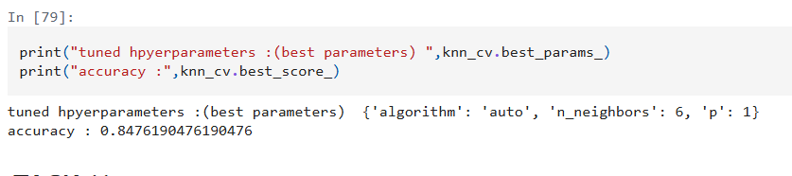
Appendix
You can see here the accuracy on train set for KNN is greater than Logistic Regression.

Slide 47


